Slide 1

NANOFLORIDA INTERNATIONAL CONFERENCE 2026
PITCH COMPETITION
Pitch Deck Template Guidelines
Florida Association for Nanotechnology (FAN)
October 2-4, 2026

Slide 2

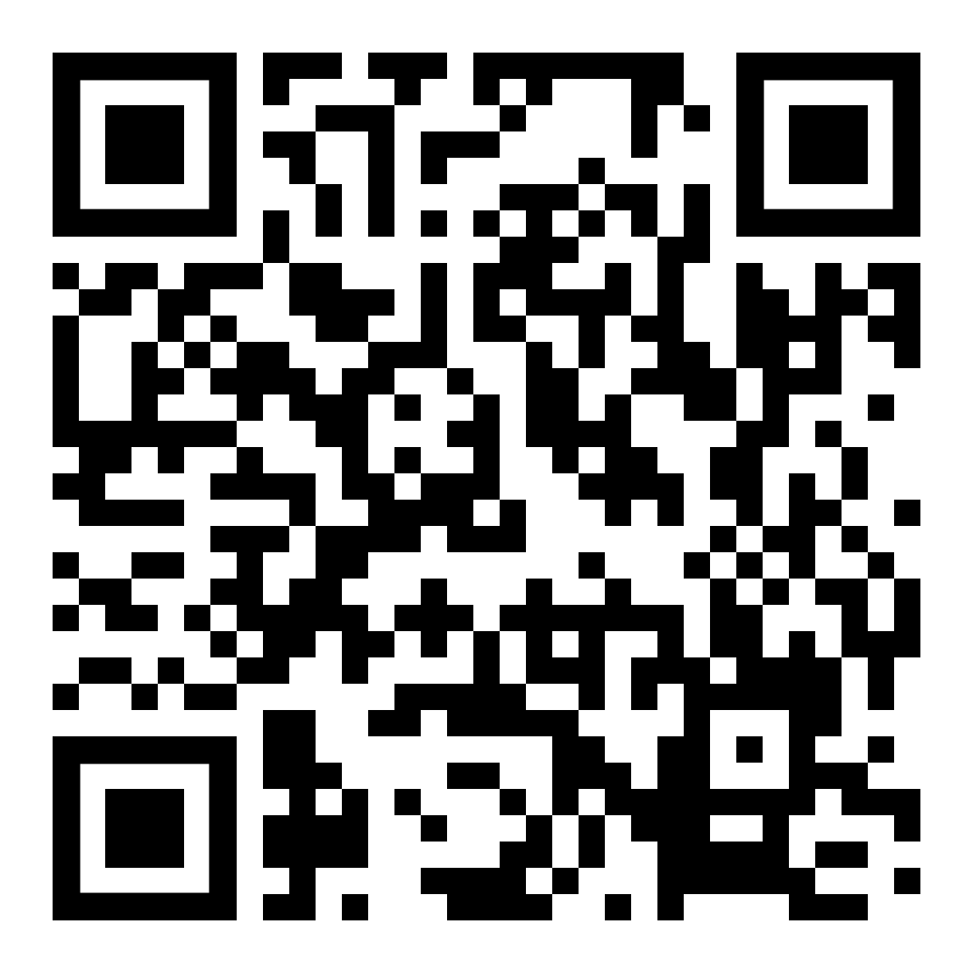
Why You Should Apply
Expert Feedback
In-Kind & Cash Prizes
Visibility
Timeline & Important Dates
Submission Deadline: Aug 20, 2026
First Round of Virtual Competition
Sep 10, 2026
Finalist Announcement:
Sep 15, 2026
Live Pitch Event: during the NanoFlorida International Conference
Oct 2-4, 2026
How to Apply
Submit both a brief executive summary (max 1 page) detailing your technology, the problem it solves, and your team
Submit your application through the link provided at FAN website
https://www.nanoflo.org/pitch
along with preliminary pitch deck based on the guidelines below.
Or scan the QR code to submit your pitch:

Slide 3
Pitch Deck Template Guidelines
Recommended Length: Max 10 Slides | Presentation Time: 5 Minutes Strictly
To ensure your pitch balances technical brilliance with business viability, please structure your deck using the following framework.
Remember, your audience includes investors who care about the business model just as much as the science!

Slide 4

Requested information
First Name:
Last Name:
Affiliation:
Email:
Pitch file instruction
Pitch file must be submitted using the following naming format:
FAN_Firstname_Lastname_Pitch

Slide 5
Slide 1: The Hook (Title Slide)
What to include: Company/Project name, a clear 1-sentence tagline explaining what you do (the "elevator pitch"), your name, and your track (Ideation vs. Startup).
Goal: Grab attention immediately.

Slide 6
Slide 2: The Problem
What to include: What is the critical real-world bottleneck or pain point you are solving? Why do current market solutions fall short?
Tip: Frame this clearly—whether it's an efficiency bottleneck in semiconductor manufacturing or an unmet clinical need in nanomedicine.

Slide 7
Slide 3: The Solution & The Science
What to include: Introduce your nanotechnology solution. How does it work?
Tip: Keep the science high-level but concrete. Use diagrams, microscopy images, or data charts to show proof-of-concept without getting bogged down in dense text.

Slide 8
Slide 4: Underlying Magic & Intellectual Property (IP)
What to include: What makes your technology unique or proprietary? What is your competitive advantage (e.g., faster, cheaper, smaller)?
Note: State your IP status (e.g., patent pending, provisionally filed, or exclusive license from university tech transfer) without disclosing confidential trade secrets.

Slide 9
Slide 5: Market Opportunity
What to include: Who is the target customer? Define your market size using standard metrics:
  TAM (Total Addressable Market)
  SAM (Serviceable Addressable Market)
  SOM (Serviceable Obtainable Market / Your initial target share)

Slide 10
Slide 6: Commercialization Pathway & Regulatory Strategy
What to include: How do you plan to scale this from the lab bench to manufacturing?
Tip: For biomedical innovations, briefly highlight your expected regulatory pathway (e.g., FDA 510(k) vs. PMA). For materials or hardware, mention your scaling or manufacturing strategy (foundry partners, thin-film deposition scalability, etc.).

Slide 11
Slide 7: Business Model
What to include: How will you make money? (e.g., direct product sales, technology licensing, joint ventures with industry primes).

Slide 12
Slide 8: The Team
What to include: Highlight the key members of your team, their technical expertise, and any advisory board members or faculty mentors supporting you. Show the Sharks you have the right minds to execute this plan.

Slide 13
Slide 9: The "Ask" & Next Milestones
What to include: What do you need next to succeed? If you are asking for funding, facility access, or mentorship, specify how it will be used to hit your next technical or business milestone (e.g., "Seeking $X to complete animal trials" or "Seeking facility access to optimize thin-film uniformity").

Slide 14
Slide 10: Conclusion & Contact
What to include: Your company logo, contact email, website/LinkedIn, and a final memorable closing statement.

